Slide 1

QTP Output Values
Presented By:
Yogesh Tiwari
Guided By:
Utpal Sir & Krishna Sir

Slide 2
Prerequisites for Checkpoints
Having Knowledge of QTP
Having Knowledge of Scripting Language

Slide 3
Discussion Topics
What Is Output Values.
Types Of Output Values.
GUI Representations & Examples.
Way To Create Output Values.

Slide 4
What Is Output Values
“An Output value step is a step in which one or more values are captured at a specific point in your test and stored for the duration of the run session. The values can later be used as input at a different point in the run session.
“Using Output values we can retrieve properties of objects ,database field values, text presenting objects and can store on data table in test result window.”

Slide 5
Types Of Output Values
Standard Output Values
Text Output Values
Text Area Output Values
Database Output values
XML Output Values

Slide 6
Standard Output values
“We can use standard output values to output the properties values of most objects. “
QTP should be in Recording mode --> Insert menu -->Output value--> standard output value --> show the object --> click OK --> select property --> If required Change the column name --> click OK -->click OK -->stop recording.
For example –
In a Web-based application, the number of links on a Web page may vary based on the selections a user makes on a form on the previous page. You could create an output value in your test to store the number of links on the page.

Slide 7
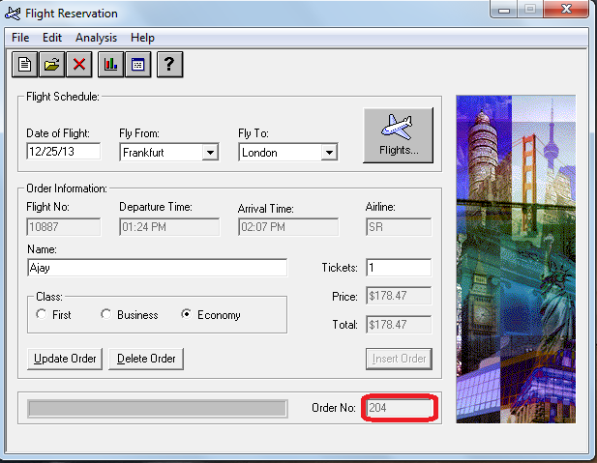
GUI Representation Of An Example
Create A Output Values on Order No.

Slide 8
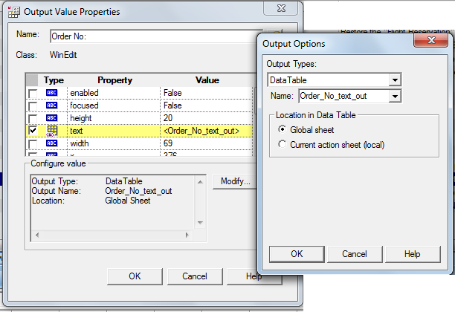
Example Continued…
Goto INSERT→OUTPUT VALUES→STANDARD OUTPUT VALUES.
In Active Screen Right Click On Order No Field and Select OUTPUT VALUES PROPERTIES Dialog Box Apears-

Slide 9
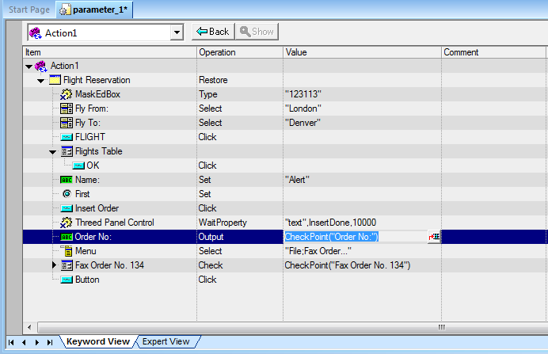
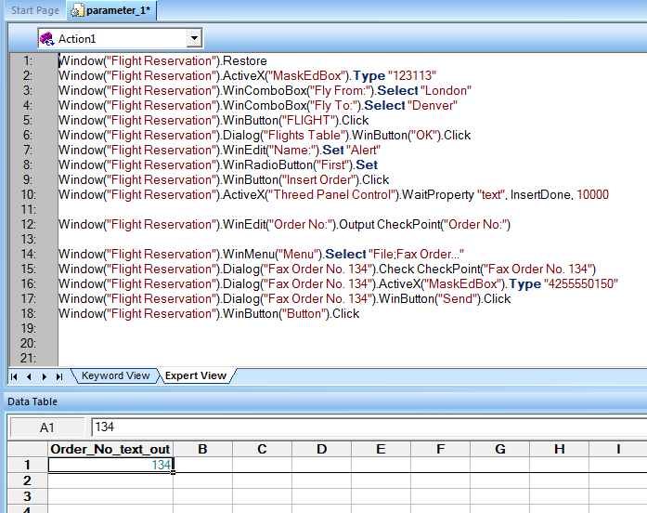
Example Continued…
We can also open Output values Properties Dialog box by keyword view-

Slide 10
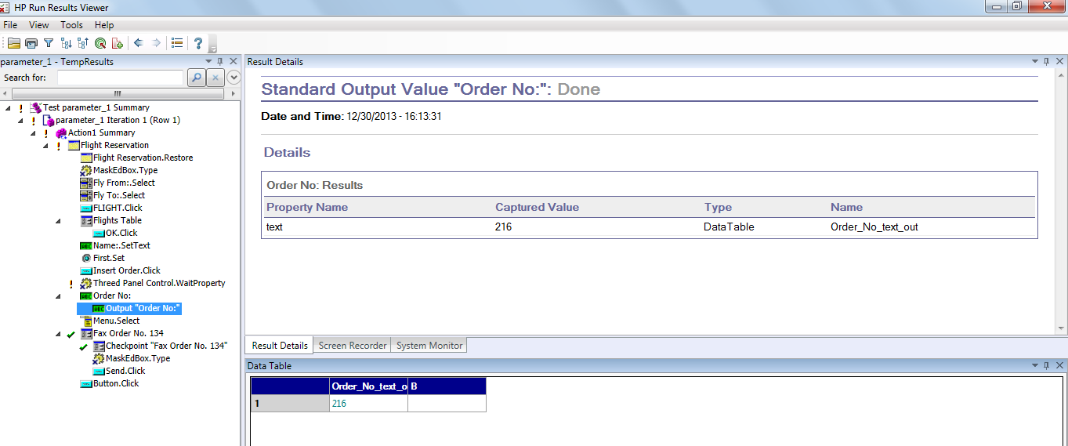
GUI Representation
After Run The Script We can Observe the Test Results.

Slide 11
Text Output Values
You can use text output values to output text strings displayed in an application. When creating a text output value, you can output a part of the object’s text. You can also specify the text before and after the output text.
For example-
Suppose that you want to store the text of any error message that appears after a specific step in the Web application you are testing.

Slide 12
Text Area Output values
Text area output values to output text strings displayed within a defined area of a screen in a Windows-based application.
You can create a text area output value only while recording on
Windows-based applications.
For example-
We can use previous example but only for window based application.

Slide 13
Database Output Values
We can use database output values to output the value of the contents of database cells, based on the results of a query (result set) that we define on a database.
Insert menu--> output value --> Database Output value--> choose specify SQL statements manually -->click next -->click create -->Select Machine Data source --> Select Driver (QT_flight32) --> click OK --> enter SQL statement {select * from orders} --> click Finish --> select data cells --> click OK --> Execute and see the results in run time table.
For example-
You can create output values from the entire contents of the
result set, or from a part of it. During the run session, QuickTest retrieves the current data from the database and outputs the values according to the settings that you specified.

Slide 14
XML Output Values
We can use XML output values to output the values of XML elements and attributes in XML documents.
For example-
Suppose that an XML document in a Web page contains a price list for new cars. You can output the price of a particular car by selecting the
appropriate XML element value to output.

Slide 15
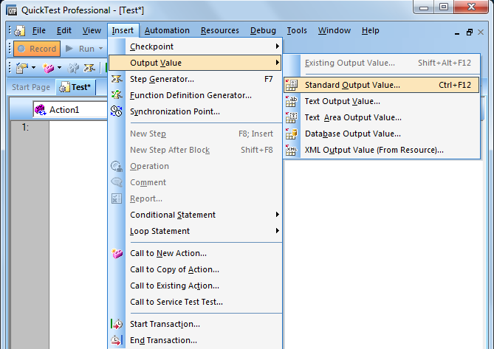
Ways To Create Output Values
We can create a Output values at the recording time of application.
Goto Insert Menu→Output Values→Then Select the type of Output Values.

Slide 16
Ways To Create Output Values…
2. We can create Output values by Expert view.
We have to put here manualy by code-

Slide 17
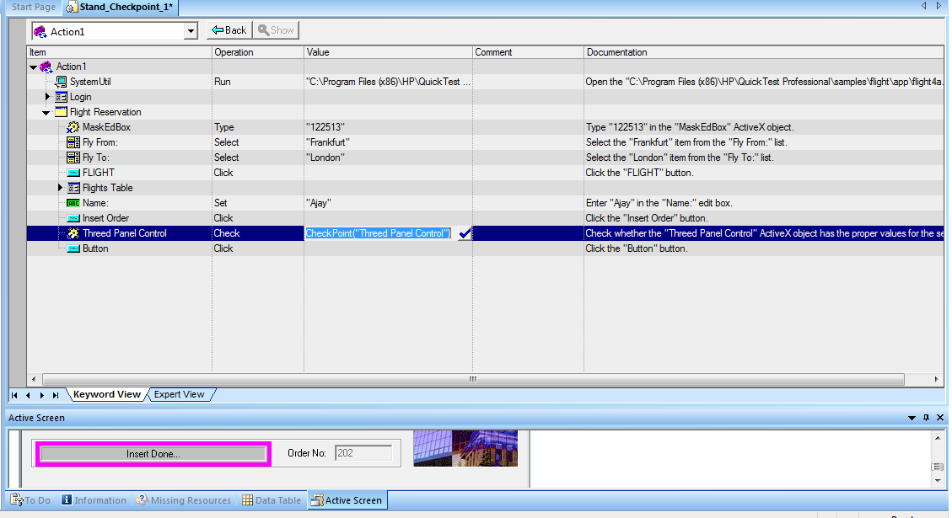
Ways To Create Output Values…
3. We can create Output Values by Keyword View.
Goto Keyword view Select Object→Click Value Coloumn of Object
→Output value dialog box apears(Checked Text attribute)→Click to
Modify Buton→You can change the Coloumn Name(If Required) →Then Click OK.

Slide 18
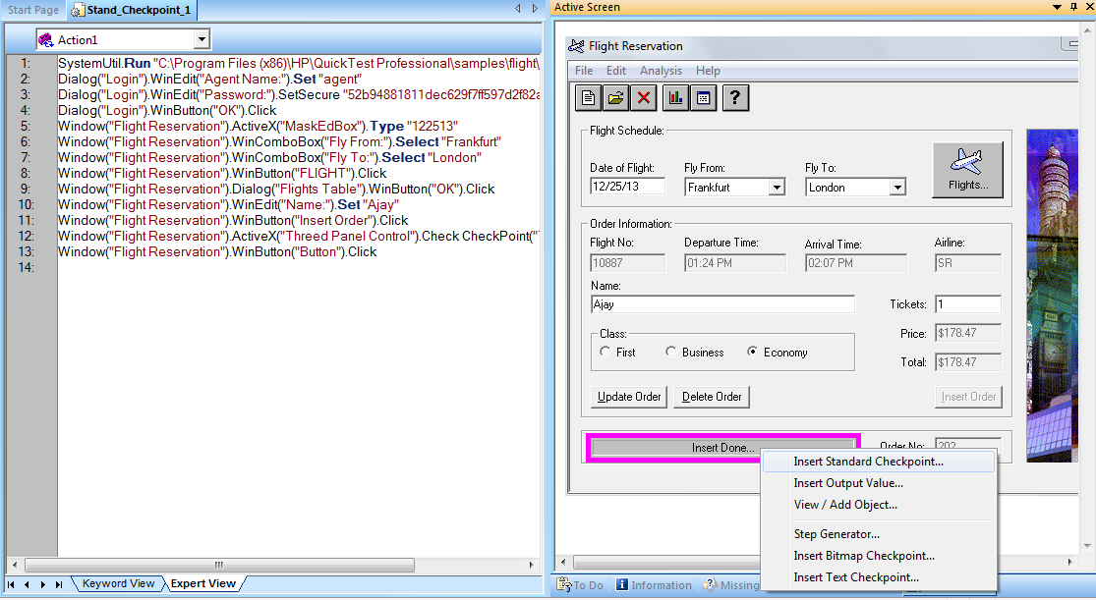
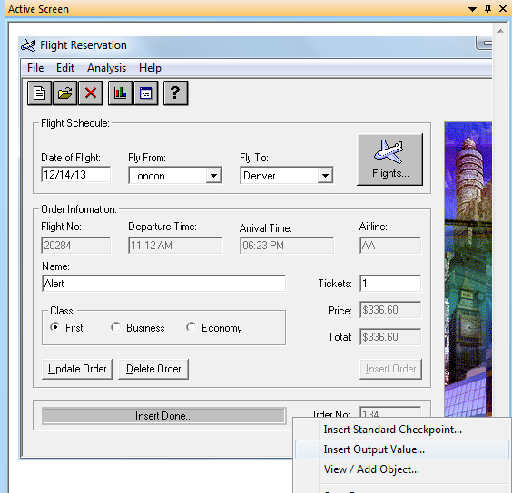
Ways To Create Output Values…
4. We can create Output Values by Active Screen Also.
Right click on object.

Slide 19
Thanks

